Slide 1

Store Visit: Canal Walk, Century City
Observation & Feedback Report

Slide 2
Problem Statement
The Canal Walk store is experiencing operational inefficiencies and service delays caused by:
Persistent technical failures (tills, scanners, switchboard)
Poor connectivity and signal issues
Space constraints in the Clothing department
While Beauty and Home show positive performance, Foods faces significant system and process disruptions that impact customer experience and staff productivity. Urgent intervention is required to restore smooth operations.

Slide 3
Fashion
Main challenge: space constraints limiting product display and navigation
• Kids wear sales performing well and remain a growth driver
• Staff highlighted the need for improved layout to ease congestion during peak times
• Opportunity: explore layout optimization or relocation of slower-moving categories

Slide 4
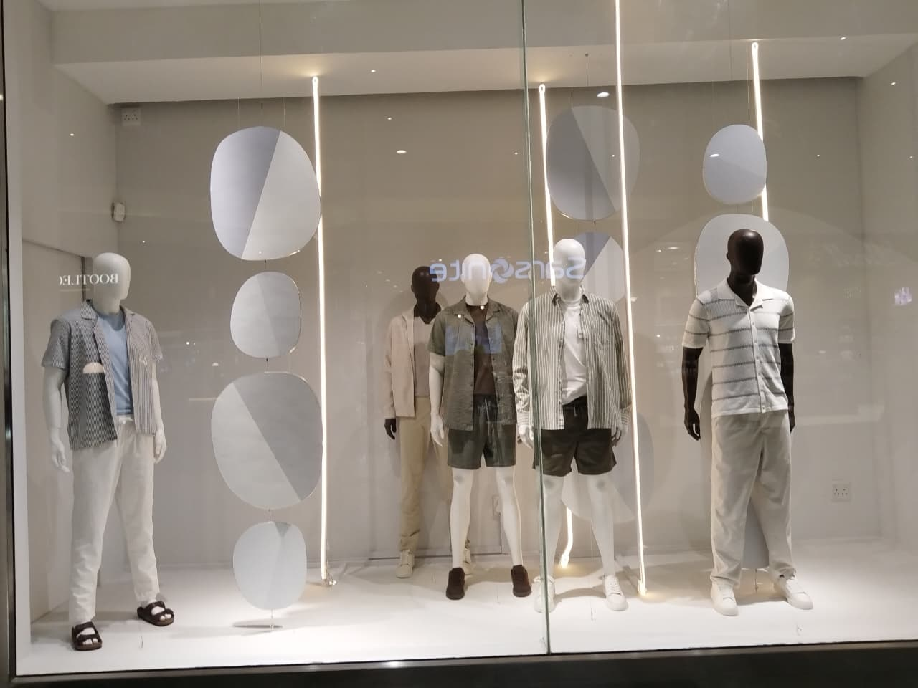
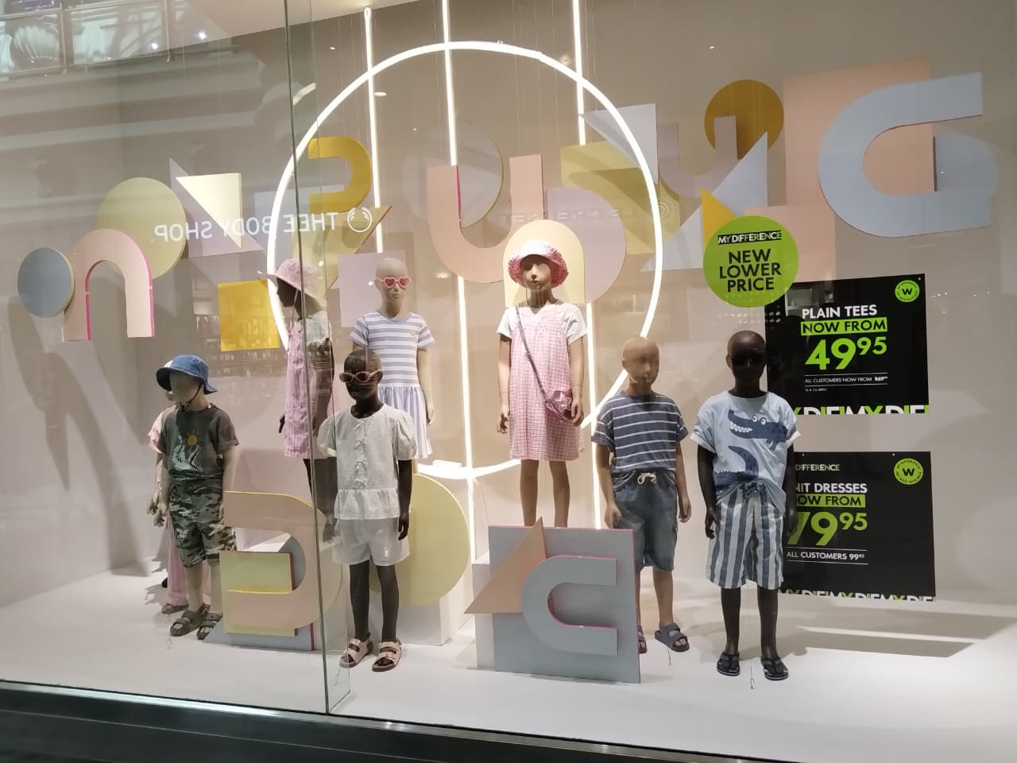
Store Experience (Fashion)

Slide 5
Beauty
• Recent product launches (e.g., skincare and fragrance) have driven noticeable sales growth
• Customers are requesting toiletry bags that are compact and handbag-friendly
• Strong potential for cross-merchandising beauty accessories with cosmetics
• Team is motivated but raised concerns about limited display space for new launches

Slide 6
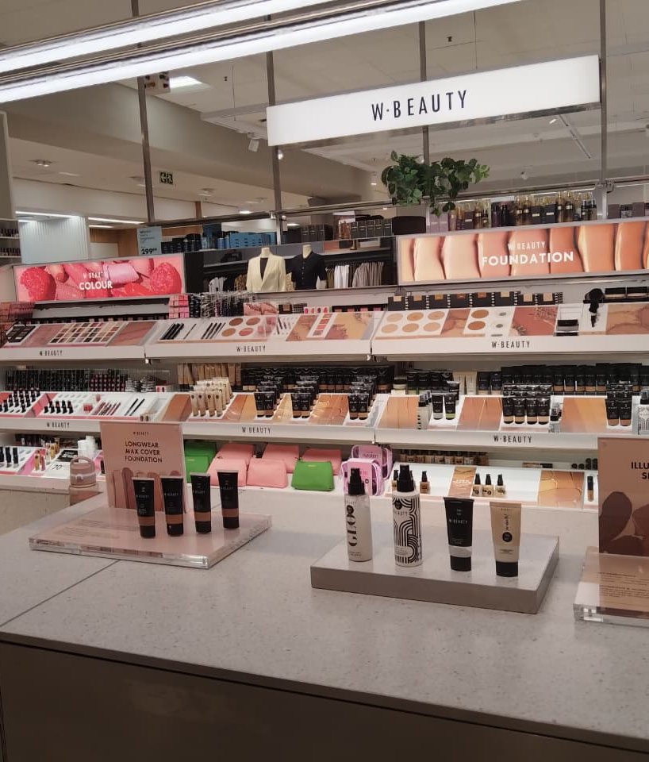
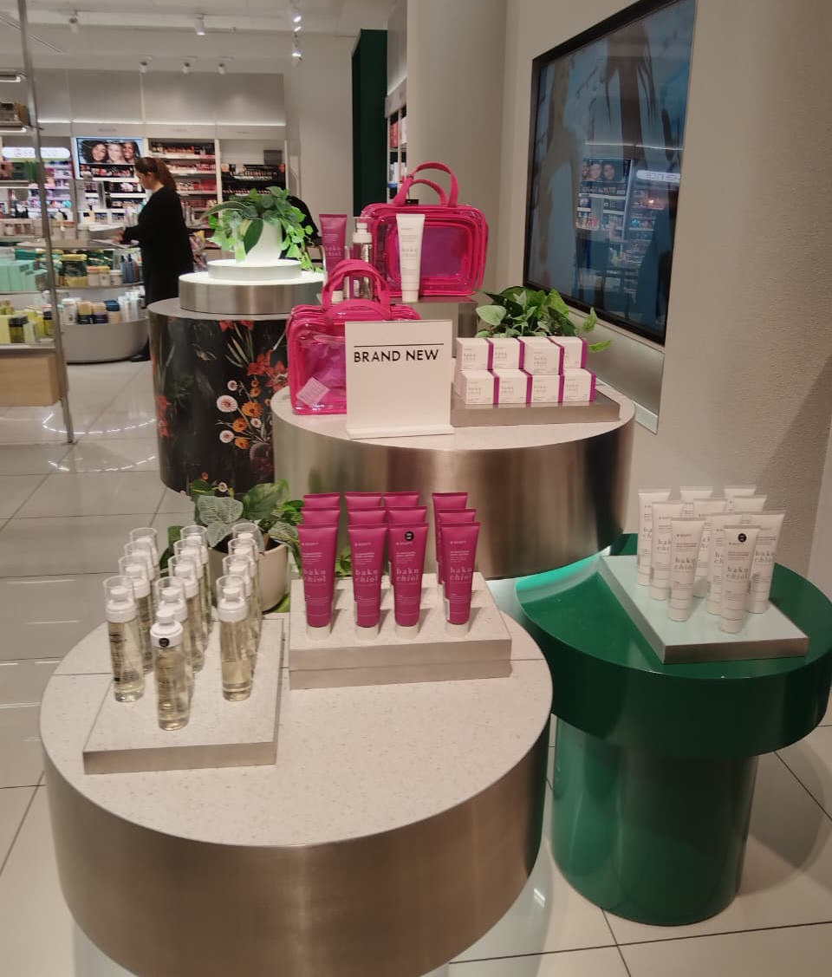
Store Experience

Slide 7
Home
• Operations are stable with no critical concerns raised
• The team is focused on Christmas setup, ensuring seasonal stock is well presented
• Visual merchandising in Home aligns with festive campaigns
• Opportunity: leverage festive season for upselling premium homeware bundles

Slide 8
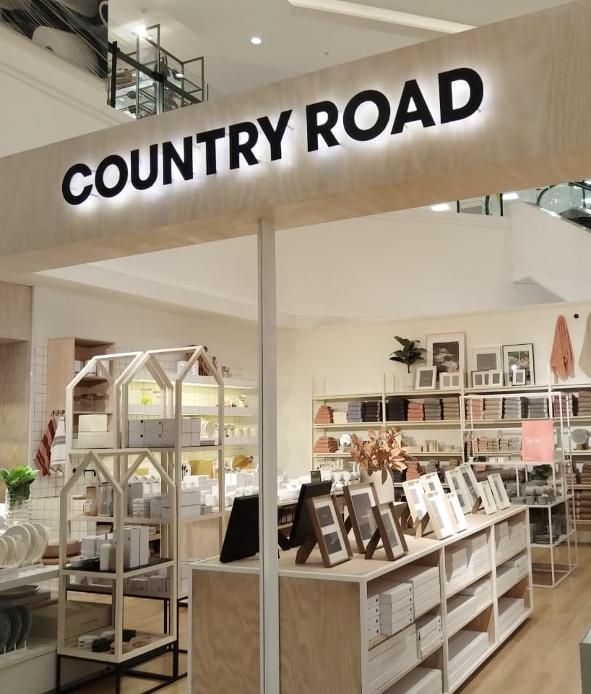
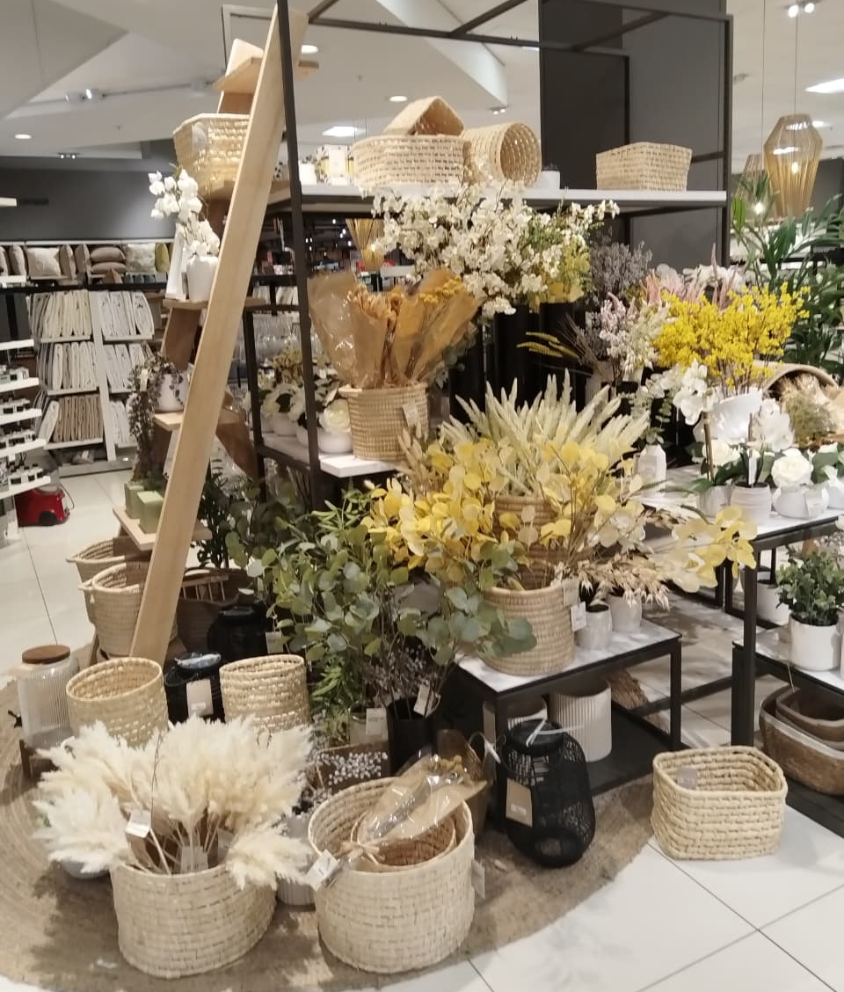
Store Experience

Slide 9
Foods (Operational Issues)
Multiple system failures impacting efficiency and customer service:
SIMS scanners not working
ECS prices not updated on 27th
Persistent signal/connectivity issues
Till #13 (Incident #4109165) unresolved despite repeated reports
Scanners unable to log out of profiles → shared logins compromise accountability
PC 'WToday' login issues
Dash scanners not functional
Till #9: role change requires call logging, delaying transactions
Scanners cannot print
Suspended transactions remain hanging
Waste till out of service → staff redirect to Kids tills, frustrating customers
Switchboard crashes → customers cannot be heard by staff
These issues directly affect sales, staff efficiency, and customer satisfaction.

Slide 10
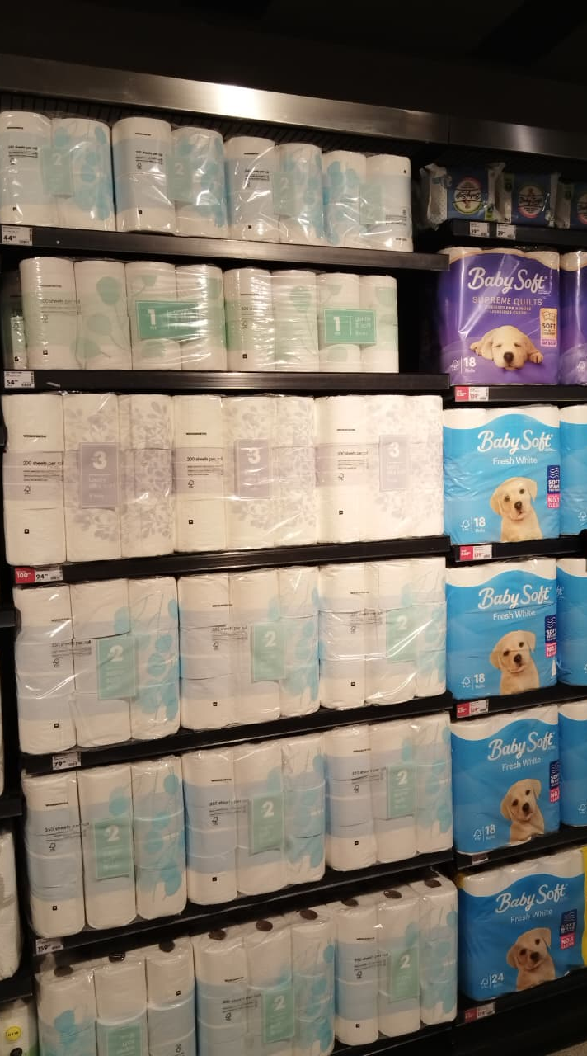
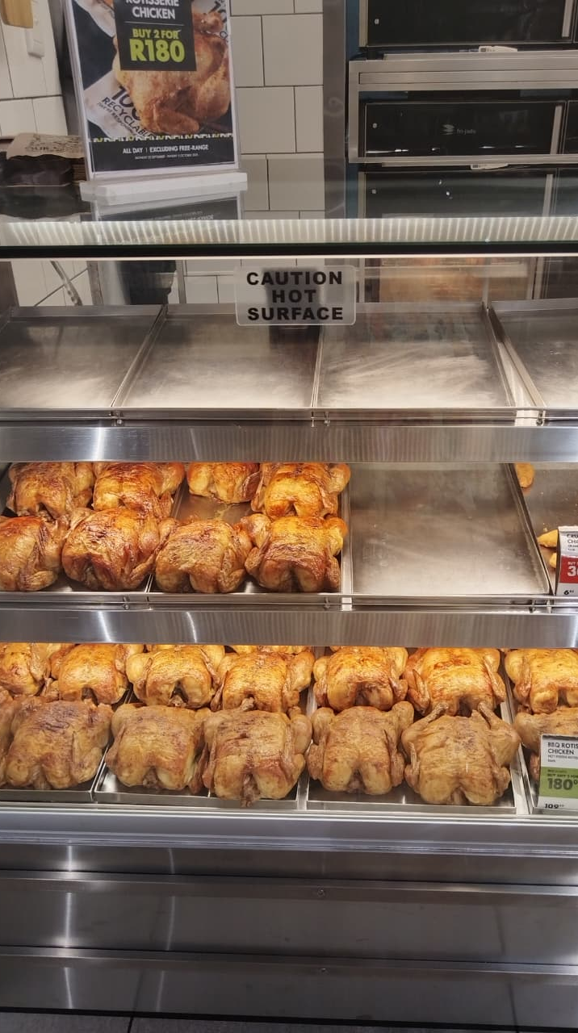
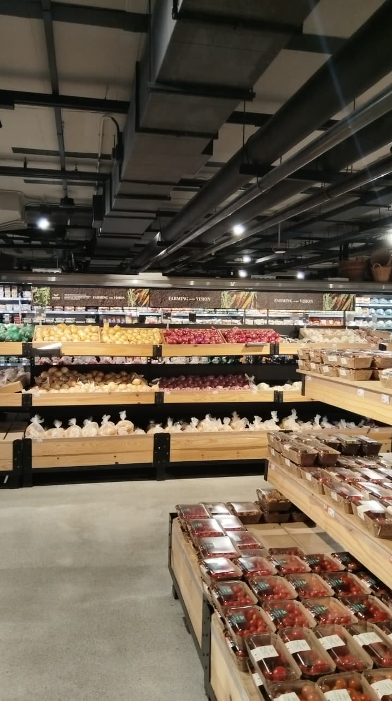
Store Experience

Slide 11
Key Stats
Store capacity shows:
1,103 trolleys available
273 shopping baskets only

Slide 12
Key Challenges (Summary)
Technical faults: tills, scanners, and switchboard failures slow service
Connectivity problems remain unresolved, disrupting multiple systems
Clothing space limitations affect customer flow and presentation
Foods team burdened with manual workarounds due to non-functional systems

Slide 13
Recommendations / Next Steps
Prioritize urgent resolution of till incidents (#4109165, Till #9, Waste till)
Escalate scanner login/printing issues with IT for permanent fixes
Review and stabilize switchboard infrastructure
Increase basket availability to balance against trolley count
Conduct store layout review in Clothing to address space challenges
Introduce proactive maintenance and quicker escalation protocol for unresolved faults
Support Beauty’s request for new toiletry bag designs and improved display space
Leverage Christmas trade in Home and Foods with bundled promotions and cross-selling

